Slide 1

LAN Design
LAN Switching and Wireless – Chapter 1
Modified by Tony Chen
04/01/2008

Slide 2
Notes:
If you see any mistake on my PowerPoint slides or if you have any questions about the materials, please feel free to email me at chento@cod.edu.
Thanks!
Tony Chen
College of DuPage
Cisco Networking Academy

Slide 3
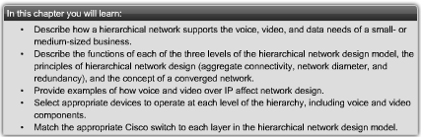
Objectives
Describe how a hierarchical network supports the voice, video and data needs of a small and medium-sized business.
Match the appropriate Cisco switch to each layer in the hierarchical network design model.

Slide 4
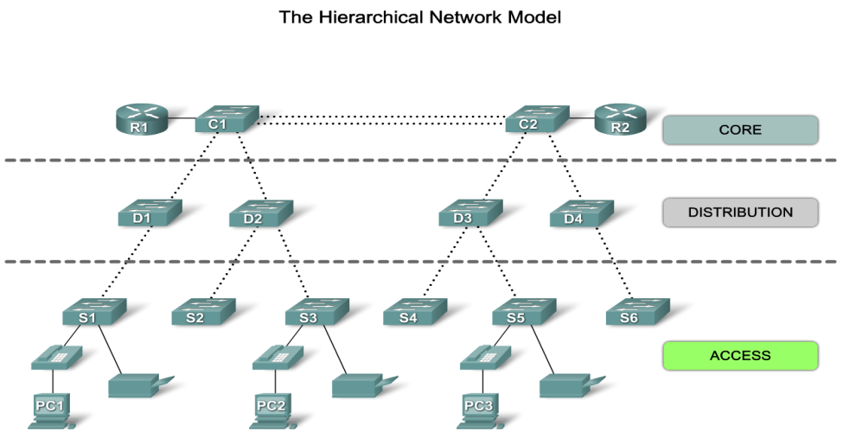
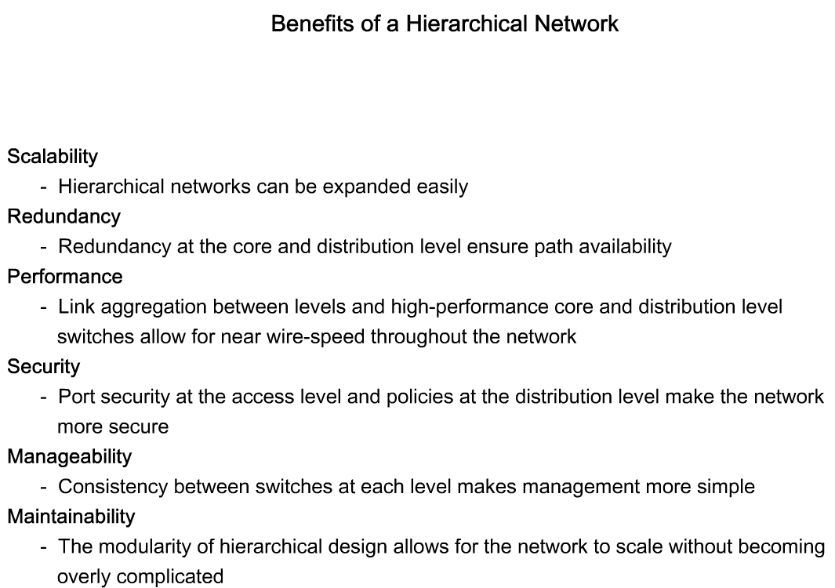
Hierarchical Network Model
When building a LAN that satisfies the needs of a small- or medium-sized business, your plan is more likely to be successful if a hierarchical design model is used.
  Hierarchical network design involves dividing the network into discrete layers.
  Each layer provides specific functions that define its role within the overall network.
  By separating the various functions that exist on a network, the network design becomes modular, which facilitates scalability and performance.
The typical hierarchical design model is broken up in to three layers:
  access
  distribution
  core
Notes:
Use graphic 1.1.1.1
Use graphic 1.1.1.3

Slide 5
Hierarchical Network Model
3 layers Hierarchical Model:
  Access
    The access layer interfaces with end devices, such as PCs, printers, and IP phones, to provide access to the rest of the network.
    The access layer can include routers, switches, bridges, hubs, and wireless access points.
    The main purpose of the access layer is to provide a means of connecting devices to the network and controlling which devices are allowed to communicate on the network.
  Distribution
  Core
Notes:
Use graphic 1.1.1.1
Use graphic 1.1.1.3

Slide 6
Hierarchical Network Model
3 layers Hierarchical Model:
  Access
  Distribution
    The distribution layer aggregates the data received from the access layer switches before it is transmitted to the core layer for routing to its final destination.
    The distribution layer controls the flow of network traffic using policies and delineates broadcast domains by performing routing functions between virtual LANs (VLANs) defined at the access layer.
    VLANs allow you to segment the traffic on a switch into separate subnetworks.
      For example, in a university you might separate traffic according to faculty, students, and guests.
    Distribution layer switches are typically high-performance devices that have high availability and redundancy to ensure reliability.
  Core
Notes:
Use graphic 1.1.1.1
Use graphic 1.1.1.3

Slide 7
Hierarchical Network Model
3 layers Hierarchical Model:
  Access
  Distribution
  Core
    The core layer of the hierarchical design is the high-speed backbone of the internetwork.
    The core layer is critical for interconnectivity between distribution layer devices, so it is important for the core to be highly available and redundant.
    The core area can also connect to Internet resources.
    The core aggregates the traffic from all the distribution layer devices, so it must be capable of forwarding large amounts of data quickly.
In smaller networks, it is not unusual to implement a collapsed core model, where the distribution layer and core layer are combined into one layer.
Notes:
Use graphic 1.1.1.1
Use graphic 1.1.1.3

Slide 8
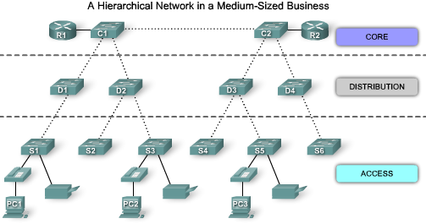
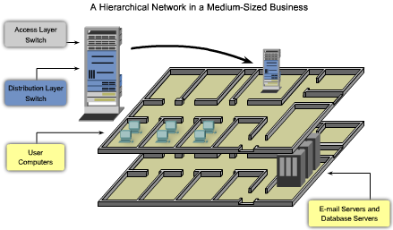
Hierarchical Network Model
Logical Layout
  The access, distribution, and core layers are separated into a well-defined hierarchy.
  This logical representation makes it easy to see which switches perform which function.
  It is much harder to see these hierarchical layers when the network is installed in a business.
Physical Layout
  The figure shows two floors of a building.
    The user computers and network devices that need network access are on one floor.
    The resources, such as e-mail servers and database servers, are located on another floor.
  To ensure that each floor has access to the network, access layer and distribution switches are installed in the wiring closets of each floor and connected to each of the devices needing network access.
  The access layer switch and distribution layer switch are stacked one on top of each other in the wiring closet.
Notes:
Use graphic 1.1.1.1
Use graphic 1.1.1.3

Slide 9

Benefits of a Hierarchical Network
Scalability
  The modularity of the design allows you to replicate design elements as the network grows.
  Because each instance of the module is consistent, expansion is easy to plan and implement.
  For example, if your design model consists of two distribution layer switches for every 10 access layer switches, you can continue to add access layer switches until you have 10 access layer switches cross-connected to the two distribution layer switches before you need to add additional distribution layer switches to the network topology.
Redundancy
  You can dramatically increase availability through easy redundant implementations with hierarchical networks.
  Access layer switches are connected to two different distribution layer switches to ensure path redundancy.
    If one of the distribution layer switches fails, the access layer switch can switch to the other distribution layer switch.
  Additionally, distribution layer switches are connected to two or more core layer switches to ensure path availability if a core switch fails.
  The only layer where redundancy is limited is at the access layer.
    Typically, end node devices, such as PCs, printers, and IP phones, do not have the ability to connect to multiple access layer switches for redundancy.
    If an access layer switch fails, just the devices connected to that one switch would be affected by the outage. The rest of the network would continue to function unaffected..
Notes:
Use graphic 1.1.1.1
Use graphic 1.1.1.3

Slide 10
Benefits of a Hierarchical Network
Performance
  Data is sent through aggregated switch port links from the access layer to the distribution layer at near wire speed in most cases.
  The distribution layer then uses its high performance switching capabilities to forward the traffic up to the core, where it is routed to its final destination.
  As a result, properly designed hierarchical networks can achieve near wire speed between all devices..
Security
  Access layer switches can be configured with various port security options that provide control over which devices are allowed to connect to the network.
  You have the flexibility to use more advanced security policies at the distribution layer.
    You may apply access control policies that define which communication protocols are deployed on your network and where they are permitted to go.
  For example, if you want to limit the use of HTTP to a specific user community connected at the access layer, you could apply a policy that blocks HTTP traffic at the distribution layer.
  Some access layer switches support Layer 3 functionality, but it is usually the job of the distribution layer switches to process Layer 3 data, because they can process it much more efficiently.
Notes:
Use graphic 1.1.1.1
Use graphic 1.1.1.3

Slide 11
Benefits of a Hierarchical Network
Manageability
  Each layer of the hierarchical design performs specific functions that are consistent throughout that layer.
    Therefore, if you need to change the functionality of an access layer switch, you could repeat that change across all access layer switches in the network because they presumably perform the same functions at their layer.
  Deployment of new switches is also simplified because switch configurations can be copied between devices with very few modifications.
  Consistency between the switches at each layer allows for rapid recovery and simplified troubleshooting.
Maintainability
  In some network design models, there is a finite limit to how large the network can grow before it becomes too complicated and expensive to maintain.
    In the hierarchical design model, switch functions are defined at each layer, making the selection of the correct switch easier.
  For a full mesh network topology to achieve maximum performance, all switches need to be high-performance switches, because each switch needs to be capable of performing all the functions on the network.
Notes:
Use graphic 1.1.1.1
Use graphic 1.1.1.3

Slide 12
Principles of Hierarchical Network Design
Hierarchical Network Design Principles
  Network Diameter
    Diameter is usually a measure of distance, but in this case, we are using the term to measure the number of devices. Network diameter is the number of devices that a packet has to cross before it reaches its destination.
  Bandwidth Aggregation
    Bandwidth aggregation is the practice of considering the specific bandwidth requirements of each part of the hierarchy.
    After bandwidth requirements of the network are known, links between specific switches can be aggregated, which is called link aggregation.
    Link aggregation allows multiple switch port links to be combined so as to achieve higher throughput between switches.
  Redundancy
    Redundancy is one part of creating a highly available network.
Notes:
Use graphic 1.1.1.1
Use graphic 1.1.1.3

Slide 13
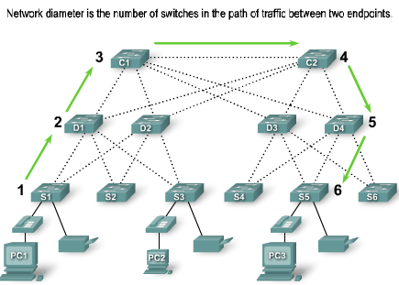
Principles of Hierarchical Network Design
Network Diameter
  When designing a hierarchical network topology, the first thing to consider is network diameter.
  Network diameter is the number of devices that a packet has to cross before it reaches its destination.
  In the figure, PC1 communicates with PC3. There could be up to six interconnected switches between PC1 and PC3. In this case, the network diameter is 6.
    Each switch in the path introduces some latency.
    Each switch has to determine the destination MAC address of the frame, check its MAC address table, and forward the frame out the appropriate port.
    Even though that entire process happens in a fraction of a second, the time adds up when the frame has to cross many switches.
  In the three-layer hierarchical model, Layer 2 segmentation at the distribution layer practically eliminates network diameter as an issue.
    In a hierarchical network, network diameter is always going to be a predictable number of hops between the source and destination devices.
    [Tony] What it is trying to said is when the frame hits the layer3 device, the diameter is reset back to 0.
We will discuss more of this diameter issue in Spanning–tree protocol chapter.
Notes:
Use graphic 1.1.1.1
Use graphic 1.1.1.3

Slide 14
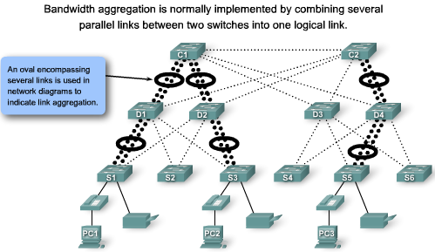
Principles of Hierarchical Network Design
Bandwidth Aggregation
  Link aggregation allows multiple switch port links to be combined so as to achieve higher throughput between switches.
  Cisco has a proprietary link aggregation technology called EtherChannel, which allows multiple Ethernet links to be consolidated.
    CCNP.
  In figure, computers PC1 and PC3 require a significant amount of bandwidth because they are used for developing weather simulations.
    The network manager has determined that the access layer switches S1, S3, and S5 require increased bandwidth.
    Following up the hierarchy, these access layer switches connect to the distribution switches D1, D2, and D4. The distribution switches connect to core layer switches C1 and C2.
  Notice how specific links on specific ports in each switch are aggregated. In this way, increased bandwidth is provided for in a targeted, specific part of the network.
  [Tony] What they are trying to said here is combining multiple physical links to create a logical link to provide more bandwidth.
  EtherChannel is a technology allows you to combine multiple physical links into one logical link.
Notes:
Use graphic 1.1.1.1
Use graphic 1.1.1.3

Slide 15
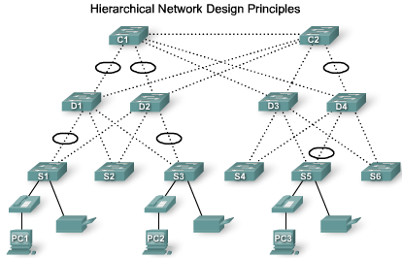
Principles of Hierarchical Network Design
Redundancy
  Redundancy is one part of creating a highly available network.
  Redundancy can be provided in a number of ways.
    For example, you can double up the network connections between devices, or you can double the devices themselves.
  Implementing redundant links can be expensive.
    Imagine if every switch had a connection to every switch at the next layer.
    It is unlikely that you will be able to implement redundancy at the access layer because of the cost and limited features in the end devices.
  In the figure, redundant links are shown at the distribution layer and core layer. At the distribution layer, there are two distribution layer switches, the minimum required to support redundancy at this layer.
    The access layer switches, S1, S3, S4, and S6, are cross-connected to the distribution layer switches. This protects your network if one of the distribution switches fails.
  Some network failure scenarios can never be prevented, for example, if the power goes out in the entire city, or the entire building is demolished because of an earthquake. Redundancy does not attempt to address these types of disasters.
Notes:
Use graphic 1.1.1.1
Use graphic 1.1.1.3

Slide 16
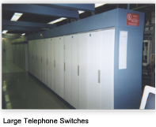
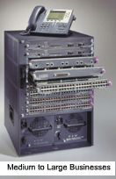
What is a Converged Network?
Small and medium-sized businesses are embracing the idea of running voice and video services on their data networks.
  Convergence is the process of combining voice and video communications on a data network.
Legacy Equipment
  Converged networks have existed for a while now, but were only feasible in large enterprise organizations
  Most telephone companies today have made the transition to digital-based switches. However, there are many offices that still use analog phones, so they still have existing analog telephone wiring closets.
Advanced Technology
  Converging voice, video, and data networks has become more popular recently in the small to medium-sized business market because of advancements in technology.
  Moving to a converged network can be a difficult decision if the business already invested in separate voice, video, and data networks.
  One benefit of a converged network is that there is just one network to manage.
  a high-end VoIP phone and switch combination suitable for a medium-sized business of 250-400 employees
Notes:
Use graphic 1.1.1.1
Use graphic 1.1.1.3

Slide 17


What is a Converged Network?
New Options
You can now tie voice and video communications directly into an employee's personal computer system.
  There is no need for an expensive handset phone or videoconferencing equipment.
    You can accomplish the same function using special software integrated with a personal computer.
  Softphones, such as the Cisco IP Communicator, offer a lot of flexibility for businesses.
    When software is used in place of a physical phone, a business can quickly convert to converged networks, because there is no capital expense in purchasing IP phones and the switches needed to power the phones.
  With the addition of inexpensive webcams, videoconferencing can be added to a softphone.
Notes:
Use graphic 1.1.1.1
Use graphic 1.1.1.3

Slide 18
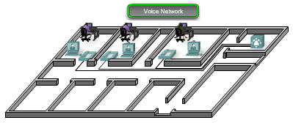
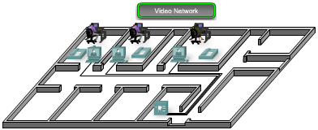
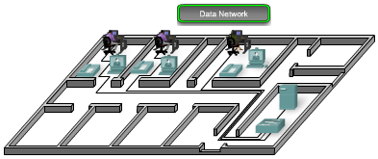
What is a Converged Network?
Separate Voice, Video and Data Networks
  Voice network
    A voice network contains isolated phone lines running to a PBX switch to allow phone connectivity to the PSTN.
    When a new phone is added, a new line has to be run back to the PBX. The PBX switch is typically located in a Telco wiring closet, separate from the data and video wiring closets.
    However, using a properly designed hierarchical network, and implementing QoS policies that prioritize the audio data, voice data can be converged onto an existing data network with little to no impact on audio quality.
  Video network
    Videoconferencing data can consume significant bandwidth on a network. As a result, video networks were maintained separately to allow the videoconferencing equipment to operate at full speed without competing for bandwidth with voice and data streams.
    Using a properly designed hierarchical network, and implementing QoS policies that prioritize the video data, video can be converged onto an existing data network with little to no impact on video quality.
  Data network
    The data network interconnects the workstations and servers on a network to facilitate resource sharing.
    Now that properly designed hierarchical networks can accommodate the bandwidth requirements of voice, video, and data communications at the same time, it makes sense to converge them all onto a single hierarchical network.
Notes:
Use graphic 1.1.1.1
Use graphic 1.1.1.3

Slide 19
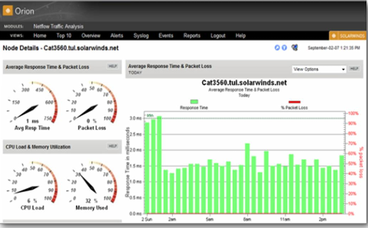
Considerations for Hierarchical Network Switches
Traffic Flow Analysis
  Traffic flow analysis is the process of measuring the bandwidth usage on a network and analyzing the data for the purpose of performance tuning, capacity planning, and making hardware improvement decisions.
  To select the appropriate switch for a layer in a hierarchical network, you need to have specifications that detail the target traffic flows, user communities, data servers, and data storage servers.
  Analyzing the various traffic sources and their impact on the network, allows you to more accurately tune and upgrade the network to achieve the best possible performance.
Analysis Tools
  Many traffic flow analysis tools that automatically record traffic flow data to a database and perform a trend analysis are available.
  The figure displays sample output from Solarwinds Orion 8.1 NetFlow Analysis, which monitors traffic flow on a network.
Notes:
Use graphic 1.1.1.1
Use graphic 1.1.1.3

Slide 20
Considerations for Hierarchical Network Switches
Analysis Tools
  For a list of some commercial traffic flow collection and analysis tools, visit http://www.cisco.com/warp/public/732/Tech/nmp/netflow/partners/commercial/index.shtml.
  For a list of some freeware traffic flow collection and analysis tools, visit http://www.cisco.com/warp/public/732/Tech/nmp/netflow/partners/freeware/index.shtml.
  [Tony] A good one to try as well
    PRTG Traffic Grapher
    http://www.paessler.com/prtg/
Notes:
Use graphic 1.1.1.1
Use graphic 1.1.1.3

Slide 21
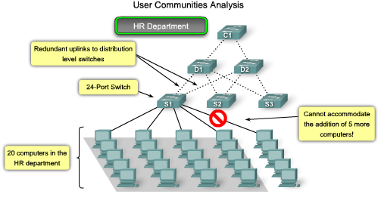
Considerations for Hierarchical Network Switches
User Communities Analysis
  User community analysis is the process of identifying various groupings of users and their impact on network performance.
    In a typical office building, end users are grouped according to their job function, because they require similar access to resources and applications.
    As shown in the figure, the HR department requires 20 workstations for its 20 users. That translates to 20 switch ports needed to connect the workstations to the network.
    If you were to select an appropriate access layer switch to accommodate the HR department, you would probably choose a 24 port switch, which has enough ports to accommodate the 20 workstations and the uplinks to the distribution layer switches.
Notes:
Use graphic 1.1.1.1
Use graphic 1.1.1.3

Slide 22
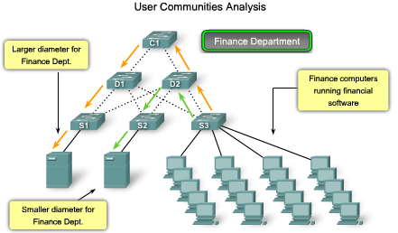
Considerations for Hierarchical Network Switches
User Communities Analysis
  The location of the user communities influences where data stores and server farms are located.
    If the Finance users are using a network-intensive application that exchanges data with a specific server on the network, it may make sense to locate the Finance user community close to that server.
    By locating users close to their servers and data stores, you can reduce the network diameter for their communications, thereby reducing the impact of their traffic across the rest of the network.
    One complication of analyzing application usage by user communities is that usage is not always bound by department or physical location. You may have to analyze the impact of the application across many network switches to determine its overall impact.
Notes:
Use graphic 1.1.1.1
Use graphic 1.1.1.3

Slide 23
Considerations for Hierarchical Network Switches
Future Growth
  A solid network plan includes the rate of personnel growth over the past five years to be able to anticipate the future growth.
    Additionally, a good network design plan factors in the growth of each department to ensure that there are enough open switch ports that can utilized before the next planned upgrade to the network.
Notes:
Use graphic 1.1.1.1
Use graphic 1.1.1.3

Slide 24
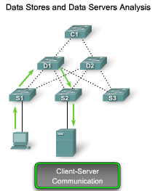
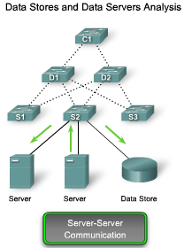
Considerations for Hierarchical Network Switches
Data Stores and Data Servers Analysis
  When analyzing traffic on a network, consider where the data stores and servers are located so that you can determine the impact of traffic on the network.
    Data stores can be servers, storage area networks (SANs), network-attached storage (NAS), tape backup units, or any other device or component where large quantities of data are stored.
  When considering the traffic for data stores and servers, consider both client-server traffic and server-server traffic.
    Client-server traffic is the traffic generated when a client device accesses data from data stores or servers.
      Client-server traffic typically traverses multiple switches to reach its destination.
      Bandwidth aggregation and switch forwarding rates are important factors to consider when attempting to eliminate bottlenecks for this type of traffic.
    Server-server traffic is the traffic generated between data storage devices on the network.
      Some server applications generate very high volumes of traffic between data stores and other servers.
      To optimize server-server traffic, servers needing frequent access to certain resources should be located in close proximity to each other so that the traffic they generate does not affect the performance of the rest of the network.
Notes:
Use graphic 1.1.1.1
Use graphic 1.1.1.3

Slide 25
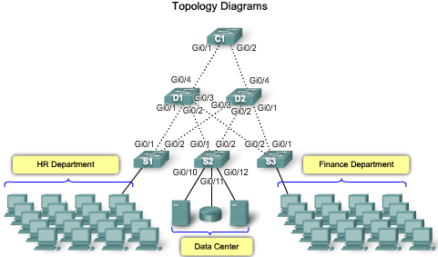
Considerations for Hierarchical Network Switches
Topology Diagrams
  A topology diagram is a graphical representation of a network infrastructure.
    A topology diagram shows how all switches are interconnected, detailed down to which switch port interconnects the devices.
    A topology diagram graphically displays any redundant paths or aggregated ports between switches that provide for resiliency and performance.
    It shows where and how many switches are in use on your network, as well as identifies their configuration.
    Topology diagrams can also contain information about device densities and user communities.
    Having a topology diagram allows you to visually identify potential bottlenecks in network traffic so that you can focus your traffic analysis data collection on areas where improvements can have the most significant impact on performance.
  A network topology can be very difficult to piece together after the fact if you were not part of the design process.
    Network cables in the wiring closets disappear into the floors and ceilings, making it difficult to trace their destinations.
    And because devices are spread throughout the building, it is difficult to know how all of the pieces are connected together.
    With patience, you can determine just how everything is interconnected and then document the network infrastructure in a topology diagram.
Notes:
Use graphic 1.1.1.1
Use graphic 1.1.1.3

Slide 26
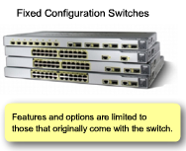
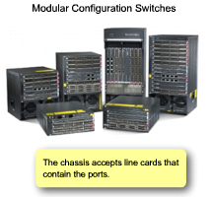
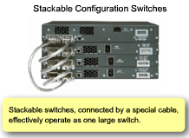
Switch Features
Switch Form Factors
  When you are selecting a switch, you need to decide between
    Fixed configuration
    Modular configuration
    Stackable
    Non-stackable.
  Another consideration is the thickness of the switch expressed in number of rack units.
    For example, the Fixed Configuration Switches shown in the figure are all 1U.
Notes:
Use graphic 1.1.1.1
Use graphic 1.1.1.3

Slide 27
Switch Features
Fixed Configuration Switches
  Fixed configuration switches means is that you cannot add features or options to the switch beyond those that originally came with the switch.
  For example, if you purchase a 24-port gigabit fixed switch, you cannot add additional ports when you need them.
  There are typically different configuration choices that vary in how many and what types of ports are included.
Modular Switches
  Modular switches typically come with different sized chassis that allow for the installation of different numbers of modular line cards.
  The line cards actually contain the ports.
  The line card fits into the switch chassis like expansion cards fit into a PC. The larger the chassis, the more modules it can support.
  As you can see in the figure, there can be many different chassis sizes to choose from. If you bought a modular switch with a 24-port line card, you could easily add an additional 24 port line card, to bring the total number of ports up to 48.
Notes:
Use graphic 1.1.1.1
Use graphic 1.1.1.3

Slide 28
Switch Features
Stackable Switches
  Stackable switches can be interconnected using a special backplane cable that provides high-bandwidth throughput between the switches.
  Cisco introduced StackWise technology in one of its switch product lines.
  As you can see in the figure, switches are stacked one atop of the other, and cables connect the switches in daisy chain fashion.
    The stacked switches effectively operate as a single larger switch.
    Stackable switches are desirable where fault tolerance and bandwidth availability are critical and a modular switch is too costly to implement.
    Using cross-connected connections, the network can recover quickly if a single switch fails.
    Stackable switches use a special port for interconnections and do not use line ports for inter-switch connections.
    The speeds are also typically faster than using line ports for connection switches.
Notes:
Use graphic 1.1.1.1
Use graphic 1.1.1.3

Slide 29


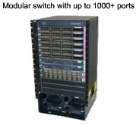
Switch Features
Performance
  When selecting a switch for the access, distribution, or core layers, consider the ability of the switch to support the
    port density,
    forwarding rates
    bandwidth aggregation
Port Density
  Port density is the number of ports available on a single switch.
    Fixed configuration switches typically support up to 48 ports on a single switch.
      If you have two switches that each contain 24 ports, you would be able to support up to 46 devices, because you lose at least one port per switch to connect each switch to the rest of the network. In addition, two power outlets are required. On the other hand,
    Modular switches can support very high port densities through the addition of multiple switch port line cards, as shown in the figure.
      For example, the Catalyst 6500 switch can support in excess of 1,000 switch ports on a single device.
      Large enterprise networks that support many thousands of network devices require high density, modular switches to make the best use of space and power.
    You must also address the issue of uplink bottlenecks.
      A series of fixed configuration switches may consume many additional ports for bandwidth aggregation between switches for the purpose of achieving target performance.
      With a single modular switch, bandwidth aggregation is less of an issue because the backplane of the chassis can provide the necessary bandwidth to accommodate the devices connected to the switch port line cards.
Notes:
Use graphic 1.1.1.1
Use graphic 1.1.1.3

Slide 30
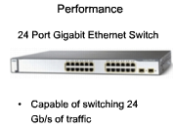
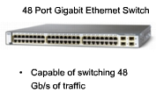
Switch Features
Forwarding Rates
  Forwarding rates define the processing capabilities of a switch by rating how much data the switch can process per second.
    If the switch forwarding rate is too low, it cannot accommodate full wire-speed communication across all of its switch ports.
      For example, a 48-port gigabit switch operating at full wire speed generates 48 Gb/s of traffic. If the switch only supports a forwarding rate of 32 Gb/s, it cannot run at full wire speed across all ports simultaneously.
    Fortunately, access layer switches typically do not need to operate at full wire speed because they are physically limited by their uplinks to the distribution layer.
      This allows you to use less expensive, lower performing switches at the access layer, and use the more expensive, higher performing switches at the distribution and core layers, where the forwarding rate makes a bigger difference.
Notes:
Use graphic 1.1.1.1
Use graphic 1.1.1.3

Slide 31
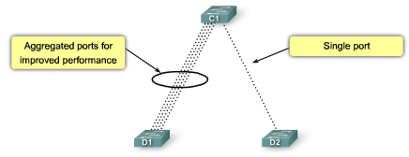
Switch Features
Link Aggregation
  As part of bandwidth aggregation, you should determine if there are enough ports on a switch to aggregate to support the required bandwidth.
    For example, consider a Gigabit Ethernet port, which carries up to 1 Gb/s of traffic. If you have a 24-port switch, with all ports capable of running at gigabit speeds, you could generate up to 24 Gb/s of network traffic.
      If the switch is connected to the rest of the network by a single network cable, it can only forward 1 Gb/s of the data to the rest of the network.
      That results in 1/24th wire speed available to each of the 24 devices connected to the switch.
    Link aggregation helps to reduce these bottlenecks of traffic by allowing up to 8 switch ports to be bound together for data communications, providing up to 8 Gb/s of data throughput when Gigabit Ethernet ports are used.
      Cisco uses the term EtherChannel when describing aggregated switch ports.
      As you can see in the figure, four separate ports on switches C1 and D1 are used to create a 4-port EtherChannel.
Notes:
Use graphic 1.1.1.1
Use graphic 1.1.1.3

Slide 32
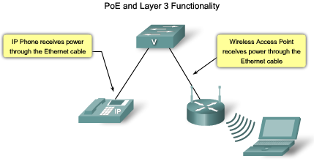
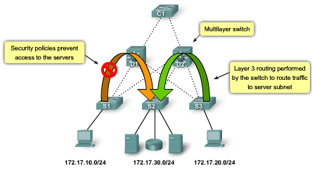
Switch Features
Power over Ethernet
  Power over Ethernet (PoE) allows the switch to deliver power to a device over the existing Ethernet cabling.
    PoE allows you more flexibility when installing wireless access points and IP phones because you can install them anywhere you can run an Ethernet cable.
    You do not need to consider how to run ordinary power to the device.
    You should only select a switch that supports PoE if you are actually going to take advantage of the feature, because it adds considerable cost to the switch.
Layer 3 Functions
  Layer 3 switches offer advanced functionality that will route traffic in layer 3 IP address.
    Layer 3 switches are also known as multilayer switches.
    Typically, switches operate at Layer 2 of the OSI reference model where they deal primarily with the MAC addresses of devices connected to switch ports.
Notes:
Use graphic 1.1.1.1
Use graphic 1.1.1.3

Slide 33
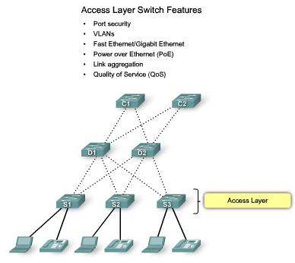
Switch Features in a Hierarchical Network
Access Layer Switch Features
  Access layer switches facilitate the connection of end node devices to the network.
  They need to support features such as:
    Port security: allows the switch to decide how many or what specific devices are allowed to connect to the switch.
      It is an important first line of defense for a network.
    VLANs: Access layer switches allow you to set the VLANs for the end node devices on your network.
      Voice traffic is typically given a separate VLAN. In this way, voice traffic can be supported with more bandwidth, more redundant connections, and improved security.
    Port speed: Fast Ethernet allows up to 100 Mb/s of traffic per switch port. Gigabit Ethernet allows up to 1000 Mb/s of traffic per switch port.
      Fast Ethernet is adequate for IP telephony and data traffic on most business networks.
      Gigabit Ethernet allows allows for much more efficient data transfers, enabling users to be more productive.
    PoE: It should only be considered when voice convergence is required or wireless access points are being implemented, and power is difficult or expensive to run to the desired location.
    Link aggregation: Access layer switches take advantage of link aggregation when aggregating bandwidth up to distribution layer.
    QoS: In a converged network supporting voice, video and data network traffic, access layer switches need to support QoS to maintain the prioritization of traffic.
      Cisco IP phones are types of equipment that are found at the access layer. QoS needs to be enabled on access layer switches so that voice traffic the IP phone has priority over, for example, data traffic.
Notes:
Use graphic 1.1.1.1
Use graphic 1.1.1.3

Slide 34
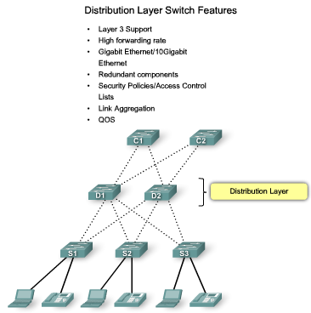
Switch Features in a Hierarchical Network
Distribution Layer Switch Features
  Distribution layer switches collect the data from all the access layer switches and forward it to the core layer switches.
  They need to support features such as
    Support Layer 3 functions: Distribution layer switches provides the inter-VLAN routing functions so that one VLAN can communicate with another on the network.
    Security Policies: Access lists are used to control how traffic flows through the network.
      This inspection is performed at the distribution layer, because the switches at this layer typically have the processing capability to handle the additional load, and it also simplifies the use of ACLs.
    Quality of Service: The distribution layer switches need to support QoS to maintain the prioritization of traffic coming from the access layer switches that have implemented QoS.
      Priority policies ensure that audio and video communications are guaranteed adequate bandwidth to maintain an acceptable quality of service.
    Redundancy: It is important that distribution switches support redundancy for adequate availability.
      Loss of a distribution layer switch could have significant impact on the rest of the network because all access layer traffic passes through the distribution layer switches.
    Link aggregation: Typically, access layer switches use multiple links to connect to a distribution layer switch to ensure adequate bandwidth to accommodate the traffic generated on the access layer, and provide fault tolerance in case a link is lost.
      Because distribution layer switches accept incoming traffic from multiple access layer switches, they need to be able to forward all of that traffic as fast as possible to the core layer switches.
      Distribution layer switches also need high-bandwidth aggregated links back to the core layer switches.
Notes:
Use graphic 1.1.1.1
Use graphic 1.1.1.3

Slide 35
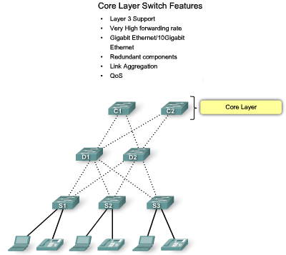
Switch Features in a Hierarchical Network
Core Layer Switch Features
  The core layer of a hierarchical topology is the high-speed backbone of the network and requires switches that can handle very high forwarding rates.
  They need to support features such as
    Link Aggregation: The core layer also needs to ensure adequate bandwidth coming into the core from the distribution layer switches.
      Core layer switches should have support for aggregated 10GbE connections, which is currently the fastest available Ethernet connectivity option.
    Redundancy: Layer 3 redundancy typically has a faster convergence than Layer 2 redundancy in the event of hardware failure.
      You want to ensure that your core layer switches support Layer 3 functions.
      Also, look for core layer switches that support additional hardware redundancy features like redundant power supplies that can be swapped while the switch continues to operate.
    QoS: An important services provided by core layer switches.
      At the core and network edge, mission-critical and time-sensitive traffic such as voice should receive higher QoS guarantees than less time-sensitive traffic such as file transfers or e-mail.
Notes:
Use graphic 1.1.1.1
Use graphic 1.1.1.3

Slide 36
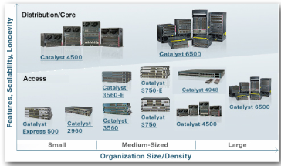
For Small and Medium Sized Business (SMB)
Cisco has seven switch product lines. Each product line offers different characteristics and features, allowing you to find the right switch to meet the functional requirements of your network.
The Cisco switch product lines are:
  Catalyst Express 500
  Catalyst 2960
  Catalyst 3560
  Catalyst 3750
  Catalyst 4500
  Catalyst 4900
  Catalyst 6500
Notes:
Use graphic 1.1.1.1
Use graphic 1.1.1.3

Slide 37
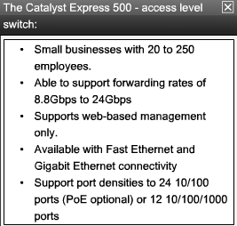
For Small and Medium Sized Business (SMB)
Catalyst Express 500
The Catalyst Express 500 is Cisco's entry-layer switch. It offers:
  Forwarding rates from 8.8 Gb/s to 24 Gb/s
  Layer 2 port security
  Web-based management
  Converged data/IP communications support
This switch series is appropriate for access layer implementations where high port density is not required. The Cisco Catalyst Express 500 series switches are scaled for small business environments ranging from 20 to 250 employees. The Catalyst Express 500 series switches are available in different fixed configurations:
  Fast Ethernet and Gigabit Ethernet connectivity
  Up to 24 10/100 ports with optional PoE or 12 10/100/1000 ports
Catalyst Express 500 series switches do not allow management through the Cisco IOS CLI. They are managed using a built-in web management interface, the Cisco Network Assistant or the new Cisco Configuration Manager developed specifically for the Catalyst Express 500 series switches. The Catalyst Express does not support console access.
To learn more about the Cisco Express 500 series of switches, go to http://www.cisco.com/en/US/products/ps6545/index.html.
Notes:
Use graphic 1.1.1.1
Use graphic 1.1.1.3

Slide 38
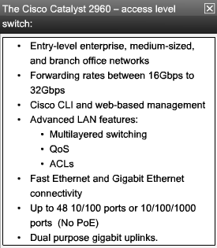
For Small and Medium Sized Business (SMB)
Catalyst 2960
The Catalyst 2960 series switches enable entry-layer enterprise, medium-sized, and branch office networks to provide enhanced LAN services.
The Catalyst 2960 series switches are appropriate for access layer implementations where access to power and space is limited.
The CCNA Exploration 3 LAN Switching and Wireless labs are based on the features of the Cisco 2960 switch.
The Catalyst 2960 series switches offers the following:
  Forwarding rates from 16 Gb/s to 32 Gb/s
  Multilayered switching
  QoS features to support IP communications
  Access control lists (ACLs)
  Fast Ethernet and Gigabit Ethernet connectivity
  Up to 48 10/100 ports or 10/100/1000 ports with additional dual purpose gigabit uplinks
The Catalyst 2960 series of switches do not support PoE.
The Catalyst 2960 series supports the Cisco IOS CLI, integrated web management interface, and Cisco Network Assistant. This switch series supports console and auxiliary access to the switch.
To learn more about the Catalyst 2960 series of switches, visit http://www.cisco.com/en/US/products/ps6406/index.html.
Notes:
Use graphic 1.1.1.1
Use graphic 1.1.1.3

Slide 39
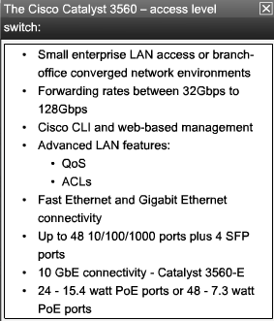
For Small and Medium Sized Business (SMB)
Catalyst 3560
The Cisco Catalyst 3560 series is a line of enterprise-class switches that include support for PoE, QoS, and advanced security features such as ACLs.
These switches are ideal access layer switches for small enterprise LAN access or branch-office converged network environments.
The Cisco Catalyst 3560 Series supports forwarding rates of 32 Gb/s to 128 Gb/s (Catalyst 3560-E switch series).
The Catalyst 3560 series switches are available in different fixed configurations:
  Fast Ethernet and Gigabit Ethernet connectivity
  Up to 48 10/100/1000 ports, plus four small form-factor pluggable (SFP) ports
  Optional 10 Gigabit Ethernet connectivity in the Catalyst 3560-E models
  Optional Integrated PoE (Cisco pre-standard and IEEE 802.3af); up to 24 ports with 15.4 watts or 48 ports with 7.3 watts
To learn more about the Catalyst 3560 series of switches, visit http://www.cisco.com/en/US/products/hw/switches/ps5528/index.html.
Notes:
Use graphic 1.1.1.1
Use graphic 1.1.1.3

Slide 40
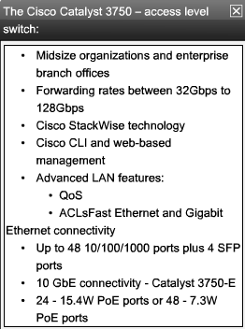
For Small and Medium Sized Business (SMB)
Catalyst 3750
The Cisco Catalyst 3750 series of switches are ideal for access layer switches in midsize organizations and enterprise branch offices.
This series offers forwarding rates from 32 Gb/s to 128 Gb/s (Catalyst 3750-E switch series).
The Catalyst 3750 series supports Cisco StackWise technology. StackWise technology allows you to interconnect up to nine physical Catalyst 3750 switches into one logical switch using a high-performance (32 Gb/s), redundant, backplane connection.
The Catalyst 3750 series switches are available in different stackable fixed configurations:
  Fast Ethernet and Gigabit Ethernet connectivity
  Up to 48 10/100/1000 ports, plus four SFP ports
  Optional 10 Gigabit Ethernet connectivity in the Catalyst 3750-E models
  Optional Integrated PoE (Cisco pre-standard and IEEE 802.3af); up to 24 ports with 15.4 watts or 48 ports with 7.3 watts
To learn more about the Catalyst 3750 series of switches, visit http://www.cisco.com/en/US/products/hw/switches/ps5023/index.html.
Notes:
Use graphic 1.1.1.1
Use graphic 1.1.1.3

Slide 41
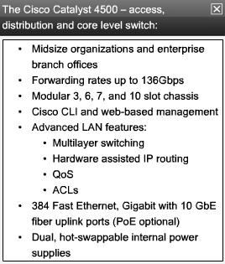
For Small and Medium Sized Business (SMB)
Catalyst 4500
The Catalyst 4500 is the first midrange modular switching platform offering multilayer switching for enterprises, small- to medium-sized businesses, and service providers.
With forwarding rates up to 136 Gb/s, the Catalyst 4500 series is capable of managing traffic at the distribution layer.
The modular capability of the Catalyst 4500 series allows for very high port densities through the addition of switch port line cards to its modular chassis.
The Catalyst 4500 series offers multilayer QoS and sophisticated routing functions.
The Catalyst 4500 series switches are available in different modular configurations:
  Modular 3, 6, 7, and 10 slot chassis offering different layers of scalability
  High port density: up to 384 Fast Ethernet or Gigabit Ethernet ports available in copper or fiber with 10 Gigabit uplinks
  PoE (Cisco pre-standard and IEEE 802.3af)
  Dual, hot-swappable internal AC or DC power supplies
  Advanced hardware-assisted IP routing capabilities
To learn more about the Catalyst 4500 series of switches, visit http://www.cisco.com/en/US/products/hw/switches/ps4324/index.html.
Notes:
Use graphic 1.1.1.1
Use graphic 1.1.1.3

Slide 42
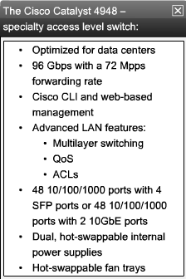
For Small and Medium Sized Business (SMB)
Catalyst 4900
The Catalyst 4900 series switches are designed and optimized for server switching by allowing very high forwarding rates.
The Cisco Catalyst 4900 is not a typical access layer switch. It is a specialty access layer switch designed for data center deployments where many servers may exist in close proximity.
This switch series supports dual, redundant power supplies and fans that can be swapped out while the switch is still running. This allows the switches to achieve higher availability, which is critical in data center deployments.
The Catalyst 4900 series switches support advanced QoS features, making them ideal candidates for the back-end IP telephony hardware. Catalyst 4900 series switches do not support the StackWise feature of the Catalyst 3750 series nor do they support PoE.
The Catalyst 4900 series switches are available in different fixed configurations:
  Up to 48 10/100/1000 ports with four SFP ports or 48 10/100/1000 ports with two 10GbE ports
  Dual, hot-swappable internal AC or DC power supplies
  Hot-swappable fan trays
To learn more about the Catalyst 4900 series of switches, visit http://www.cisco.com/en/US/products/ps6021/index.html.
Notes:
Use graphic 1.1.1.1
Use graphic 1.1.1.3

Slide 43
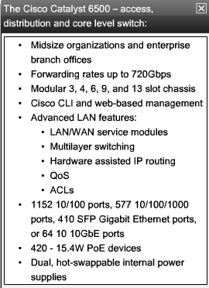
For Small and Medium Sized Business (SMB)
Catalyst 6500
The Catalyst 6500 series modular switch is optimized for secure, converged voice, video, and data networks.
The Catalyst 6500 is capable of managing traffic at the distribution and core layers. The Catalyst 6500 series is the highest performing Cisco switch, supporting forwarding rates up to 720 Gb/s.
The Catalyst 6500 is ideal for very large network environments found in enterprises, medium-sized businesses, and service providers.
The Catalyst 6500 series switches are available in different modular configurations:
  Modular 3, 4, 6, 9, and 13 slot chassis
  LAN/WAN service modules
  PoE up to 420 IEEE 802.3af Class 3 (15.4W) PoE devices
  Up to 1152 10/100 ports, 577 10/100/1000 ports, 410 SFP Gigabit Ethernet ports, or 64 10 Gigabit Ethernet ports
  Dual, hot-swappable internal AC or DC power supplies
  Advanced hardware-assisted IP routing capabilities
To learn more about the Catalyst 6500 series of switches, visit http://www.cisco.com/en/US/products/hw/switches/ps708/index.html
Notes:
Use graphic 1.1.1.1
Use graphic 1.1.1.3

Slide 44
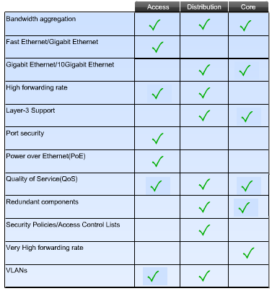
For Small and Medium Sized Business (SMB)
Notes:
Use graphic 1.1.1.1
Use graphic 1.1.1.3

Slide 45
Summary
Hierarchical Design model addresses performance, scalability, maintainability & manageability issues.
Traffic Analysis is used to monitor network performance.
Hierarchical Design Model is composed of 3 layers:
  Access
  Distribution
  Core
Switches selected for each layer must meet the needs of each hierarchical layer as well as the needs of the business.
Tony Chen COD
Cisco Networking Academy

